Slide 1

Men vs. Women
Who rules the sky (and beyond) when it comes to NASA hiring rates?
Kaity Tainer, Cynthia Cardenas, Elesha Hunter, Kendra Sawyer, Rachael Reich, Stacey Gonzalez

Slide 2







Cynthia Cardenas
BA in Elementary Education
Rachael Reich
BA Mechanical Engineering
Elesha Hunter
Stacey Gonzalez
BA Political Science
BS Sociology
MS Psychology MPH Public Health and Epidemiology Phd International Psychology
Kaity Tainer
BA Psychology
Kendra Sawyer
BS Music Education

Slide 3
Background
The 70’s: a springboard for women in astronomy
Women had worked behind the scenes since 1922
Cinema popularized women in the field
A popular one: Star Trek

Slide 4
Goals
Use Python for data analysis
Wrangle data
Data analysis
Data visualization
Gather findings

Slide 5
Assumptions/Predictions

Slide 6
Wrangle Data
Data sets varied in information given
Needed to hone into our end goal
Data sets used:
(All will be linked and sourced here)
(Explain columns that needed to be removed or merged)

Slide 7
Exploratory Analysis

Slide 8
Variables

Slide 9
Correlations

Slide 10
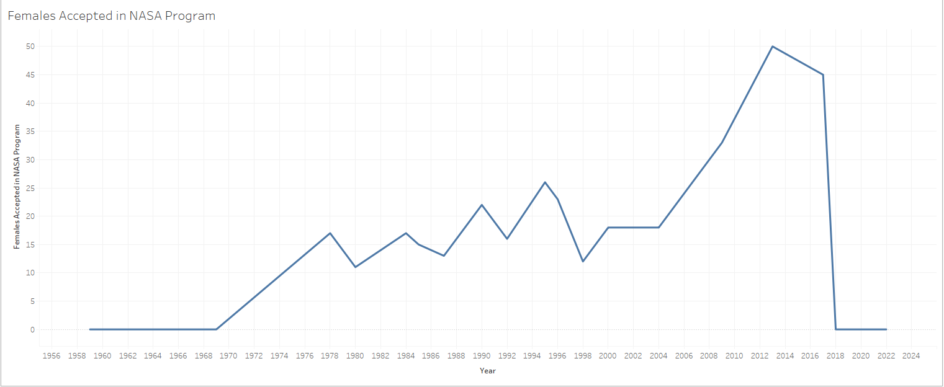
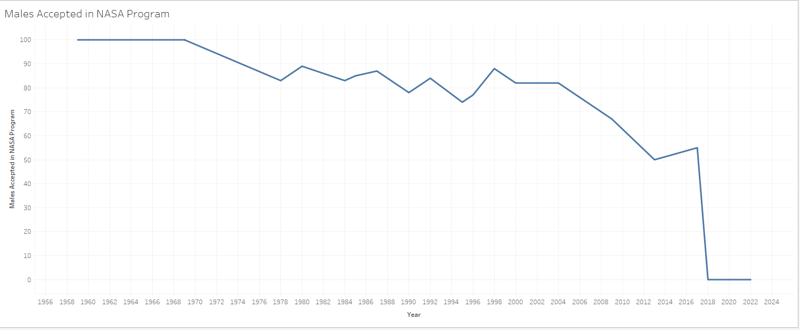

Slide 11
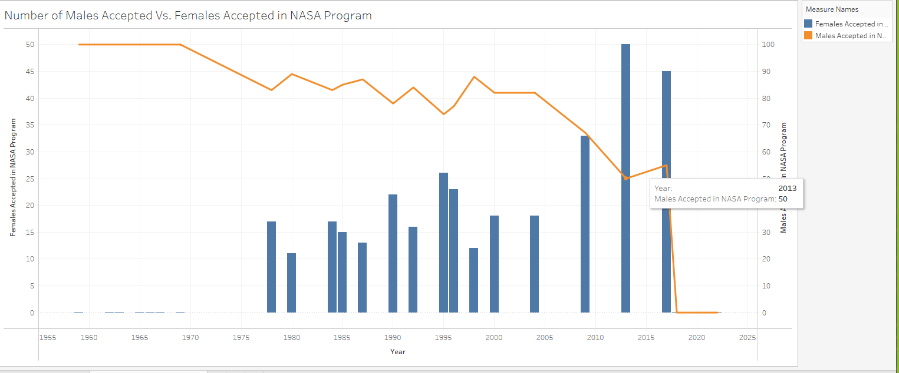

Slide 12
Data Analysis

Slide 13
Statistical Significance?

Slide 14
Summary/Regroup

Slide 15
(Next analysis questions based on what we found)

Slide 16
(Additional wrangling that was required)

Slide 17
(Visual representation for additional queries)

Slide 18
Conclusions

Slide 19
Questions?

